Slide 1
Intro to SharePoint 2019
What’s New
Notes:
SharePoint 2016 aligned on-premises SharePoint with the SharePoint online code base, but didn't provide a lot of new features visible to regular users. The upcoming release of SharePoint 2019 will begin to introduce many of the SharePoint online features that business users have been waiting for. In this talk we'll review all the new features being introduced in SharePoint 2019 including: - Modern UI for Sites, Pages, Lists, and Libraries - SharePoint Home - Team News and Communication Sites - Improved support for SharePoint Framework development (SPFX) - NextGen OneDrive Sync Client support - PowerApps and Flow integration
Large File Support
Improved hybrid support and scenarios – (Some specific features related to hybrid are: a new SharePoint Hybrid status bar, OneDrive in Office 365 by Default, and “Modern Search.”)
https://collab365.community/sharepoint-2019-features-announced/

Slide 2
Paul Papanek Stork
Owner/Principal Architect
Don’t Pa..Panic Consulting
Author
Developer’s Guide to WSS 3.0
MOSS 2007 Best Practices
MCTS: WSS 3.0 Configuration Study Guide (70-631)
SharePoint 2010 Development for Office 365
Microsoft Community Contributor
Technet Forums
MSDN Forums
Yammer Groups
Contact Information
Email: pstork@att.net
Blog: http://dontPaPanic.com/blog
Twitter: @PStork
Notes:
Principal SharePoint Architect for BlueChip Consulting Group
http://www.bluechip-llc.com
SharePoint MVP for 9 years
SharePoint Microsoft Certified Master
Author
Developer’s Guide to WSS 3.0
MOSS 2007 Best Practices
MCTS: WSS 3.0 Configuration Study Guide (70-631)
SharePoint 2010 Development for Office 365
Contact Information
Email: Paul.Stork@bluechip-llc.com
Blog: http://dontPaPanic.com/blog
Twitter: @PStork

Slide 3
Agenda
Major Improvements in Three Areas
The Modern UI comes to On-Premises
Better Office 365 Integration
Robust Scale, Security, and Compliance
Removed or Deprecated

Slide 4
SharePoint 2016 vs. 2019
SharePoint 2016 merging the codebase with the cloud
Minroles
Old Office 365 App Launcher
SharePoint 2019 brings the Online user experience
Modern UI
Full SPFX Web part support
New App Launcher

Slide 5
The Modern UI comes to On-Premises

Slide 6
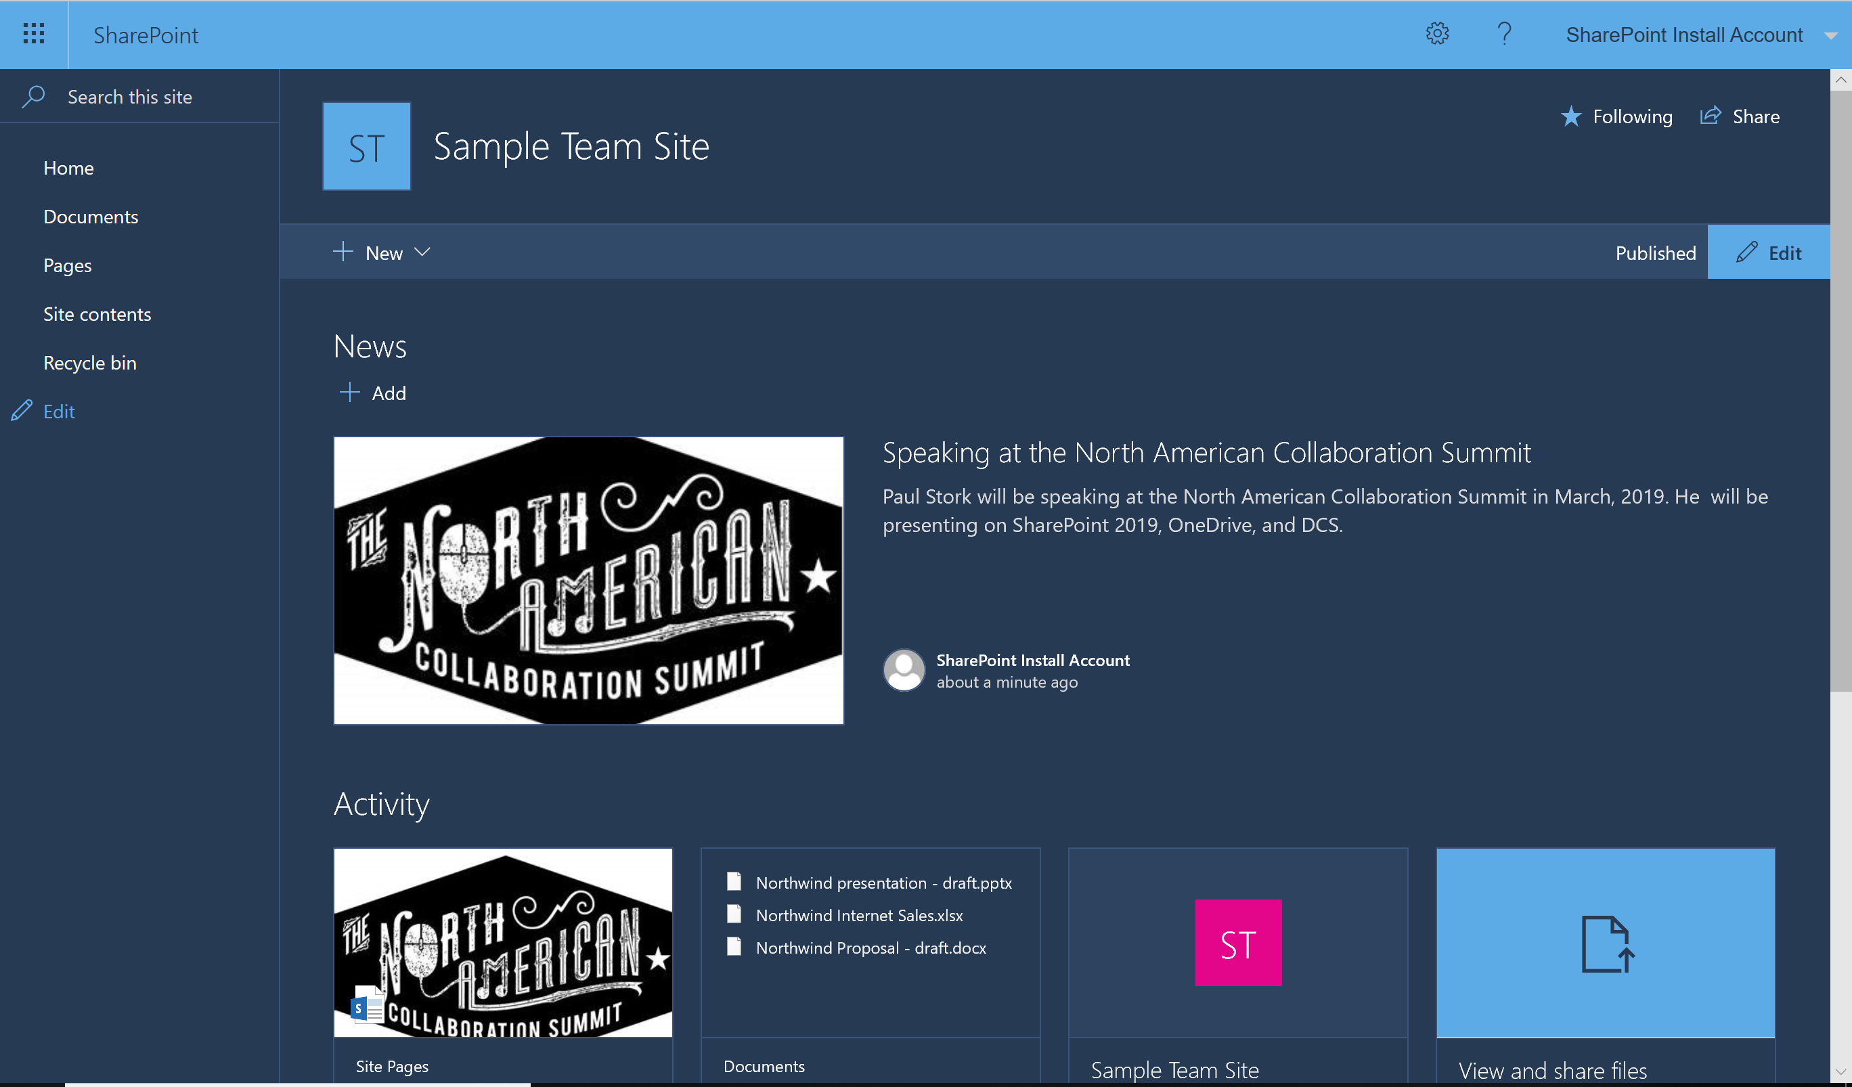
The Modern Team Site
Integrated with Office 365 Groups
SPFX Web parts
Mobile Friendly Responsive Design
No Pre-built Lists
Announcements
Calendar
Links

Slide 7
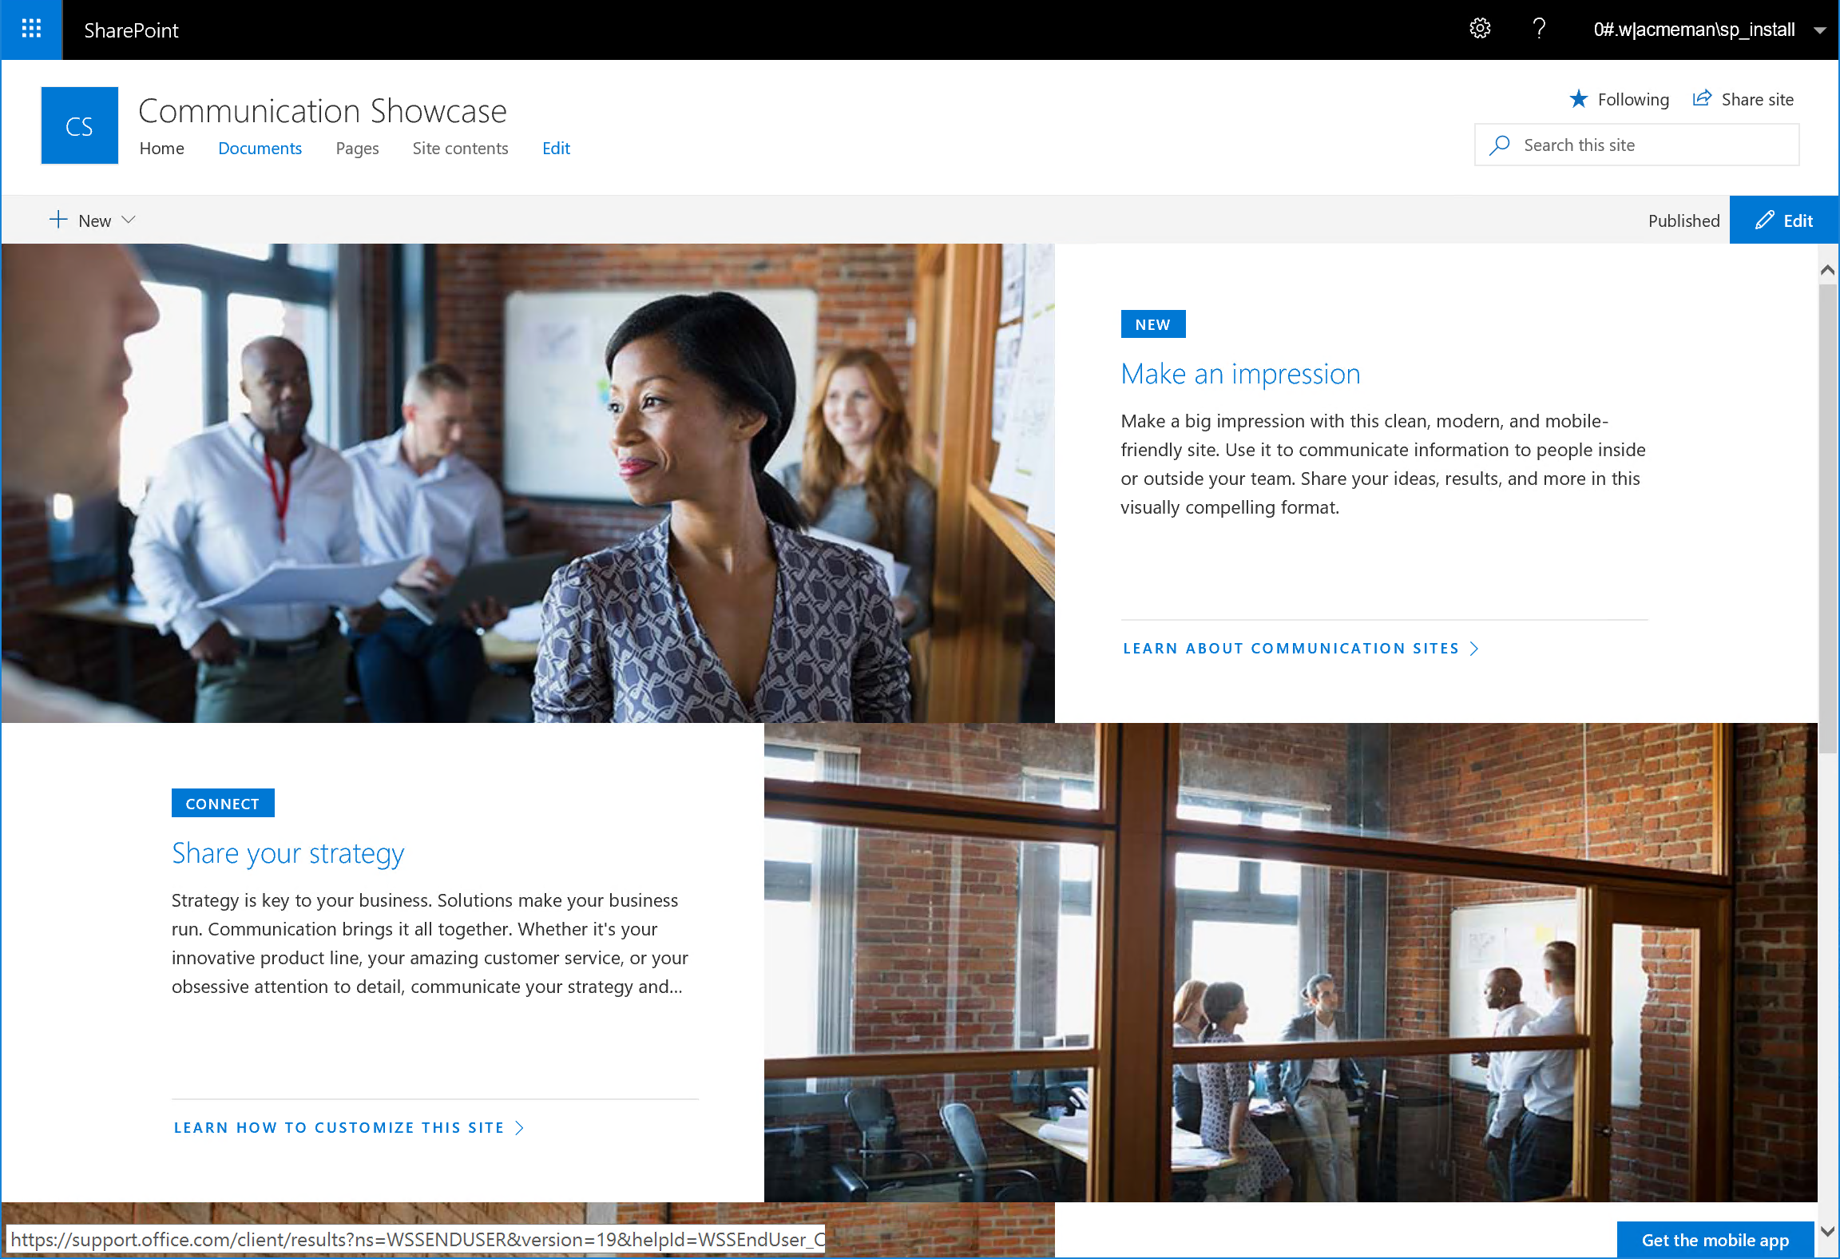
The Modern Communication Site
Shares information
With a Broader Audience
Shares News
Shares Events
Shares Topics
Doesn’t require Publishing Features
No Left Nav

Slide 8
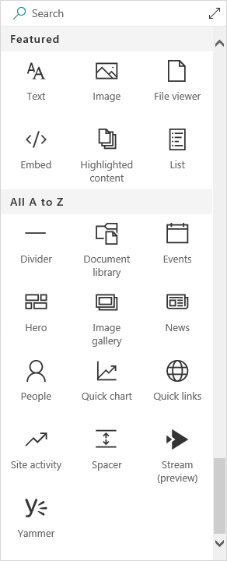
Modern Pages & Web Parts
Easier to create and edit pages
Mobile ready responsive design
More Modern SPFX Web parts
Flexible layout that can be changed

Slide 9
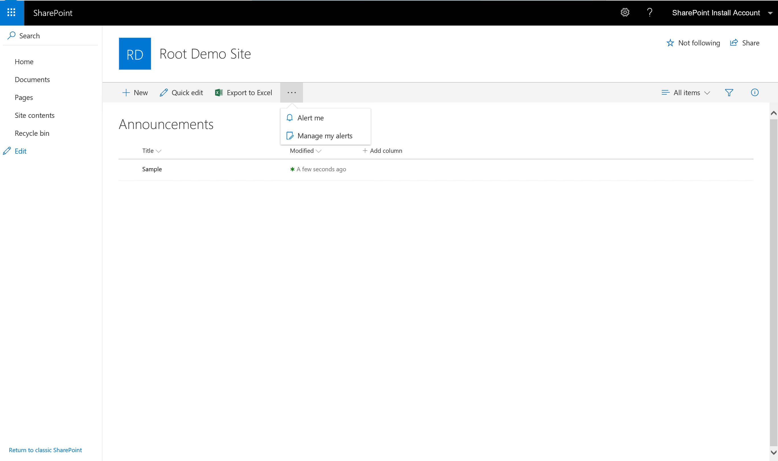
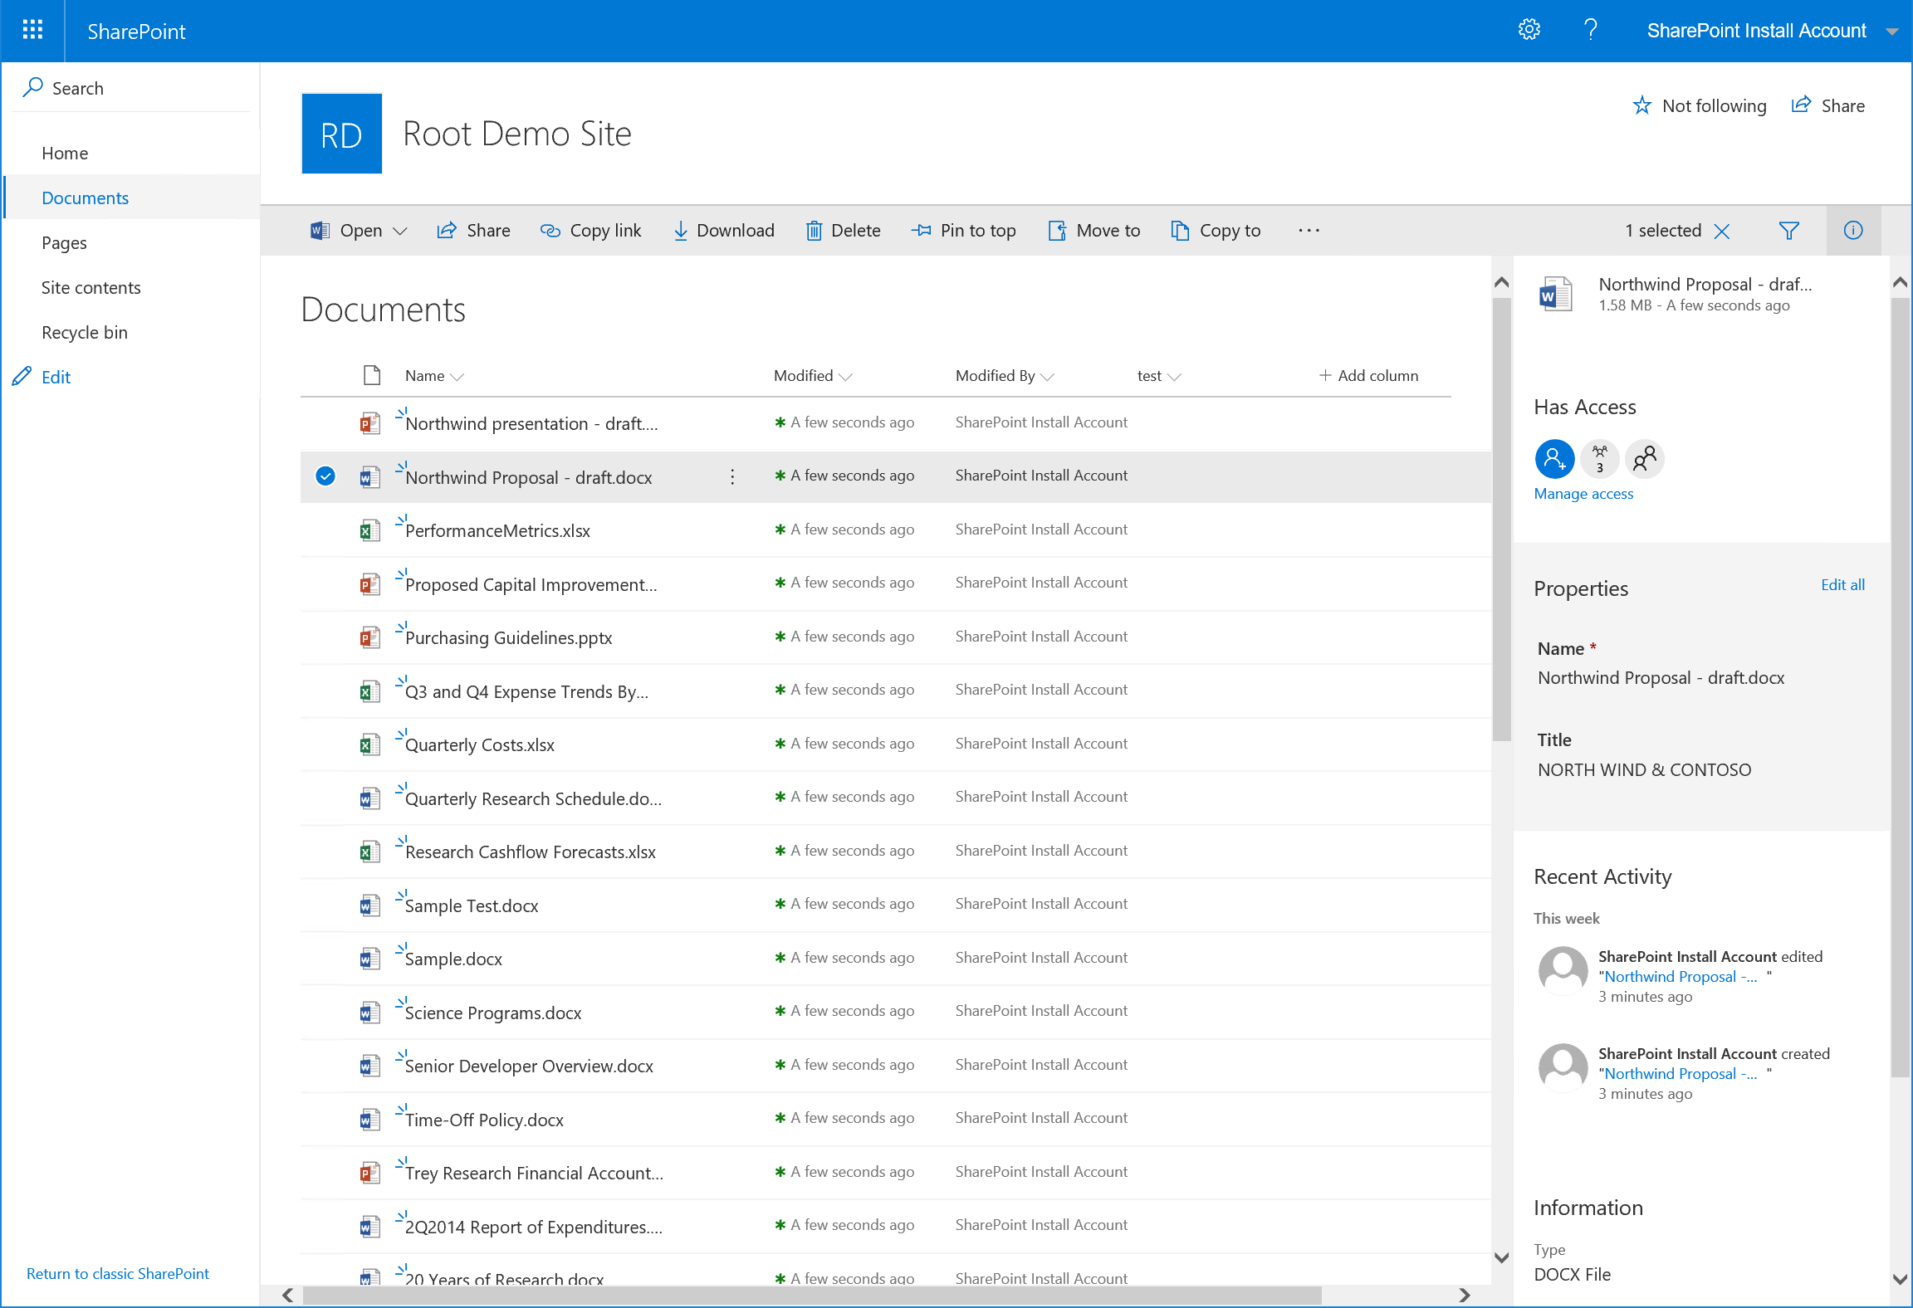
Modern UI Lists and Libraries
Modern UI Libraries
OneDrive Sync Compatible
Modern Menus
Modern UI Lists
Easier to Add Columns
Better Column Filtering
New Property Pane with more Information

Slide 10
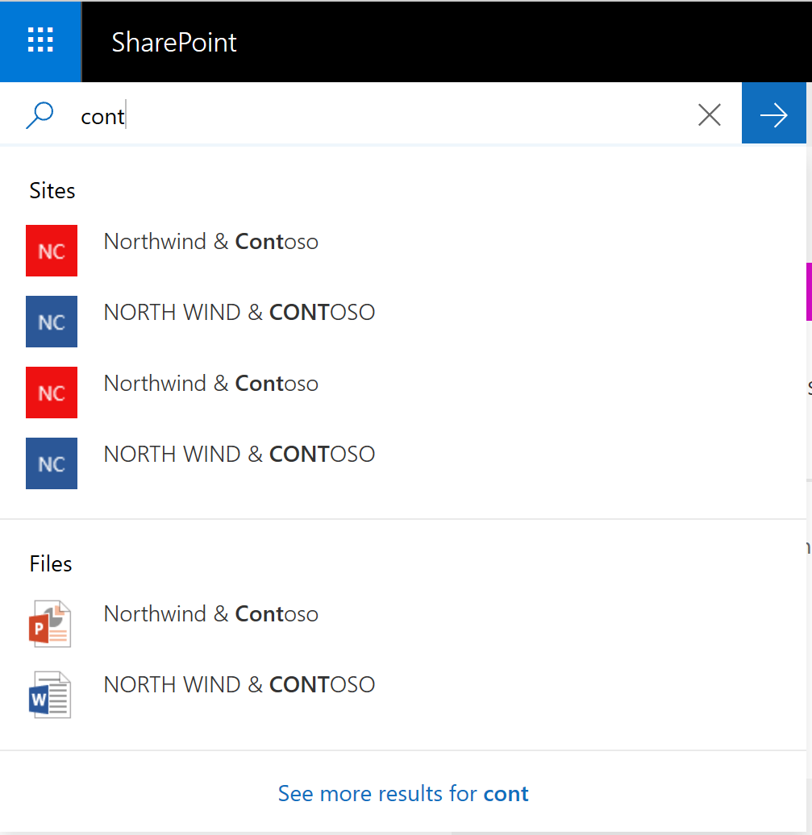
Modern Search Experience
Type Ahead Contextual Search
Multiple Content Categories displayed
Filter by Result Types
New Modern Search Results Page
Return to original page after searching

Slide 11
Developer Improvements
SPFXclient-side web parts
SPFX extensions in modern experiences
Webhooks for list items
Asset packaging and JavaScript hosting from app catalog
"Tenant" scoped deployment of SPFX
SharePoint Framework version 1.4.1

Slide 12
Still On the Roadmap
Site Designs and Site Scripts
Hub sites
Site collection app catalog
"Tenant" properties
Ability to customize modern themes

Slide 13
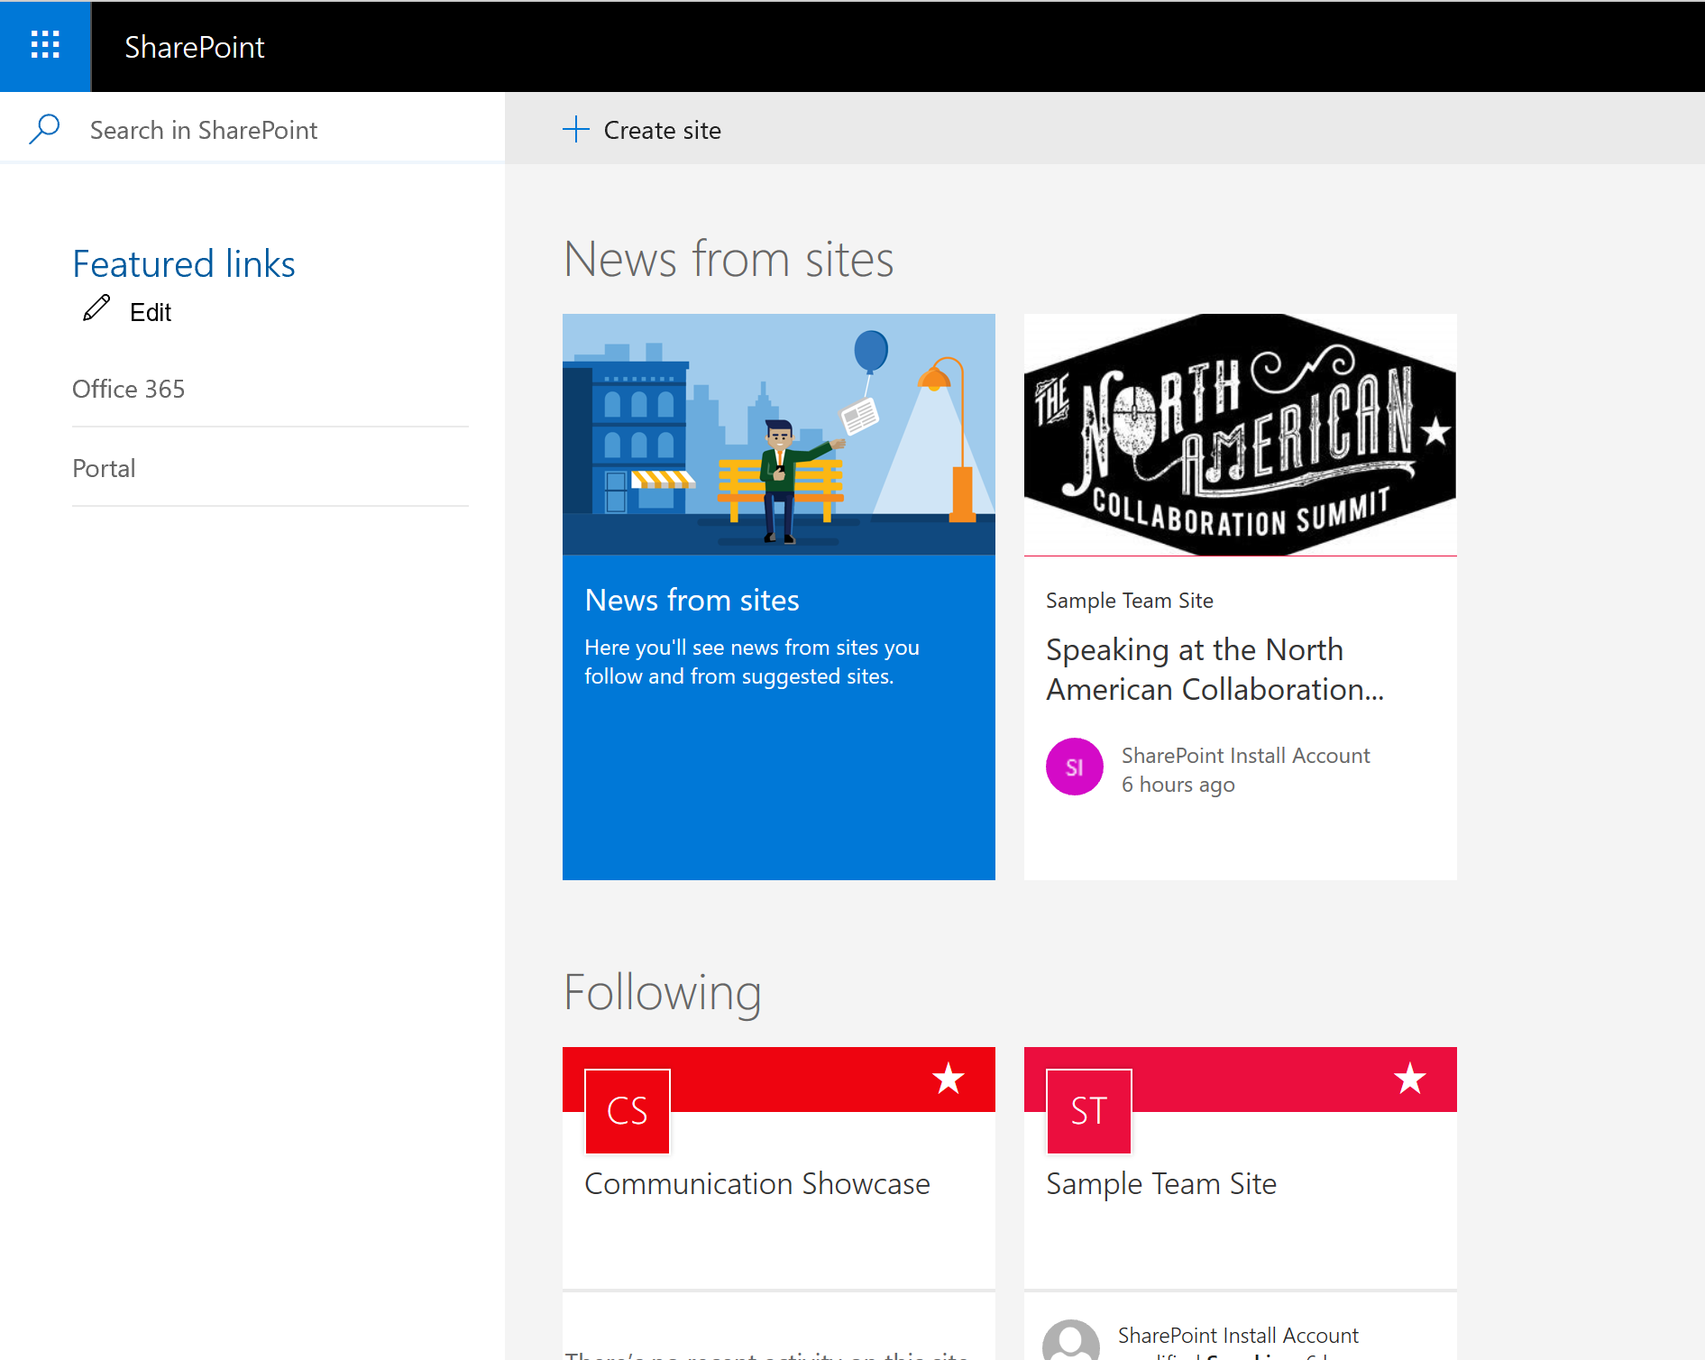
SharePoint Home
Easier Site Creation
Modern Team Site
Communication Site
Fast Site Creation
OneDrive Site provisioning
Modern Team Site
Communication Site
Improved Navigation to Recent, Important, Followed Sites

Slide 14
The Modern UI On-Premises
Notes:
Unified Sharing Dialogue
Link Expiration for Anonymous
Code for specific email

Slide 15
Better Office 365 Integration

Slide 16
Business Process Improvements
PowerApps and Flow Integration through On-Premises Gateway*
Improved Workflow Manager (CU5)
No PowerApps List Form customization
No SharePoint Workflow Manager 2019
* Starting Feb 1, 2019 the On-Premises Gateway requires premium licensing

Slide 17
Other Improvements
Hybrid Wizard Embedded in Central Admin
Next Gen OneDrive client can sync document libraries

Slide 18
Improved Scalability & Compliance

Slide 19
Improved Scalability and Limits
Larger File upload size (15GB vs 10GB in SP 2016)
URL path length restriction increased to 400 from 260
URL document path encoding shortened
SMTP Authentication for Outgoing Email
Documentation Links from Central Admin
Use of # and % characters in file names

Slide 20
Removed or Deprecated

Slide 21
Deprecated
Access Services & Access Services 2010
Aggregated Newsfeed
Custom Help
InfoPath Client / InfoPath Services (end of support 2026)
Lists web service
Machine Translation service
PerformancePoint Services
SharePoint Designer 2013 (end of support 2026)
Site Mailbox
Site Manager

Slide 22
Be Sure To Thank Our Sponsors!

Slide 23
Get Drink Tickets and Wristband During Closing Session Thursday

Slide 24
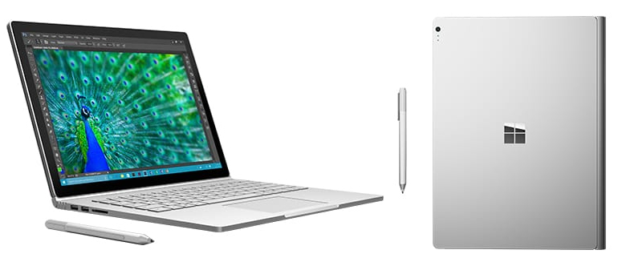
Win a Surface Book courtesy of Microsoft!
Play Vendor Bingo, Winner drawn during closing session on Friday

Slide 25
Questions?
Paul Papanek Stork - MCSM, MVP Owner\Principal Architect Email: pstork@dontpapanic.com Cell: 216.272.0573 Web: https://dontpapanic.com Twitter: @PStork

